Slide 1
Optical Flow
MVP Seminar
2017.07.21

Slide 2
Optical Flow with Deep Learning

Slide 3
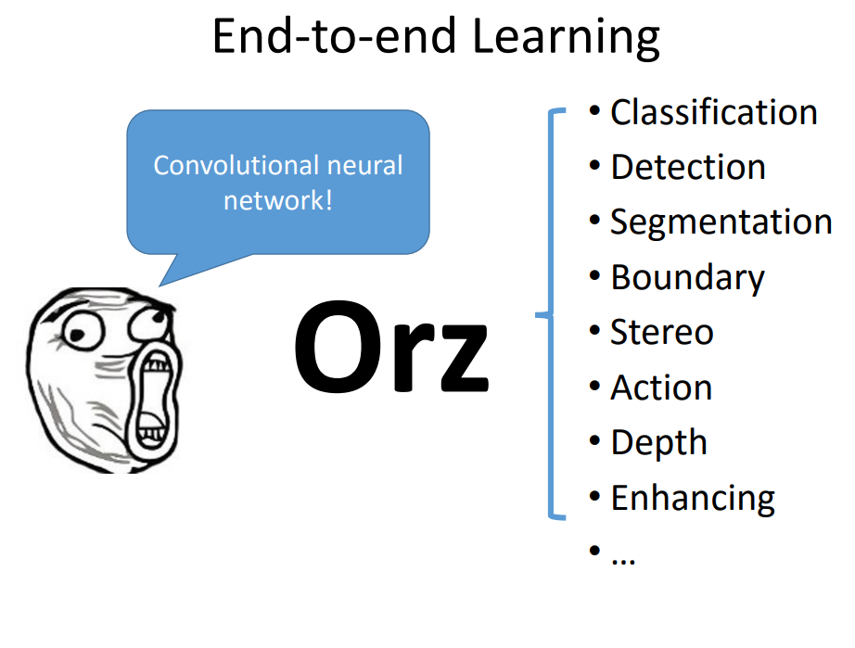

Slide 4
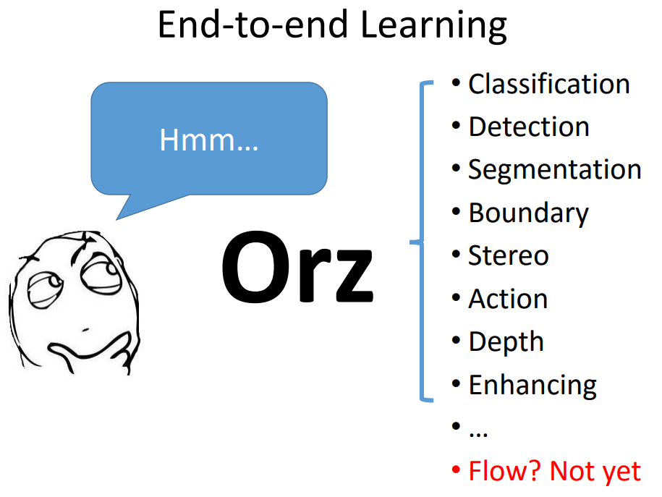

Slide 5
End-to-end Learning
Difficulties for learning optical flow
- Output is per-pixel prediction
- matching between images
- Lack of labeled data

Slide 6
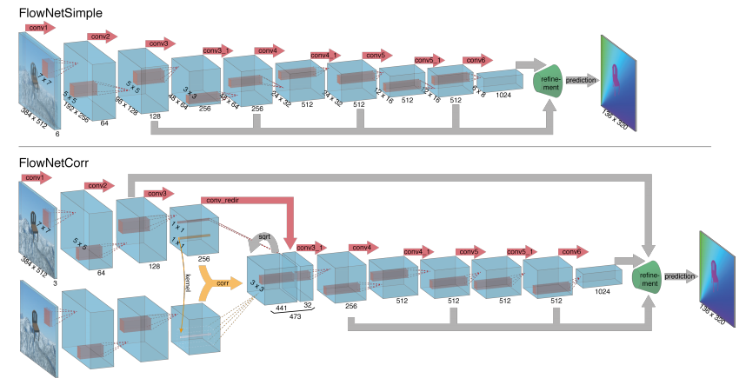
FlowNet
Matching between images (two choice)
- Stack them together
- Adding a correlation layer

Slide 7
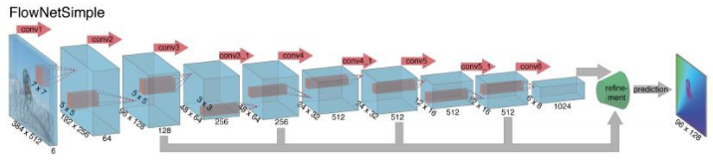
FlowNet
Matching between images (two choice)
- Stack them together
Two input images stacked
In a simpler one we process two stacked input images jointly

Slide 8
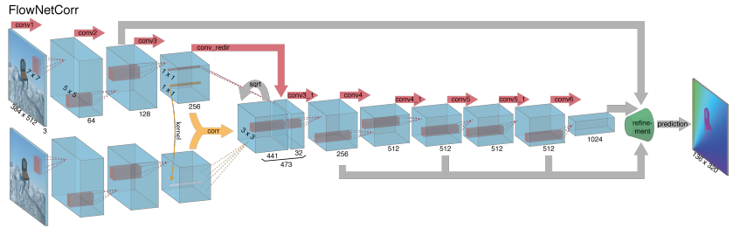
FlowNet
Matching between images (two choice)
- Adding a correlation layer
Alternatively, we first process the images separately, then corrleate their features at different locations and process further.

Slide 9
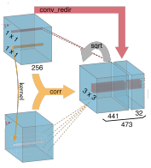
FlowNet
Corrleation Layer
1x1
41x41
21x21
1x1
41x41
relative displacement !
large
small
large
-center-

Slide 10
FlowNet
Output is per-pixel prediction
Refinement
"Upconvolution"

Slide 11
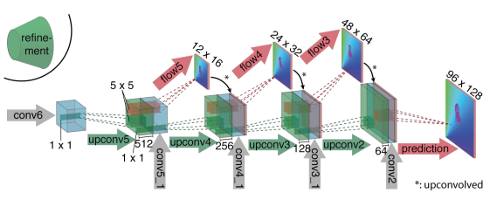
FlowNet
Output is per-pixel prediction
- Full convolutional architecture + up-sampling layer
coarse prediction + feature maps + feature maps in contractive part
=> high level information+coarse flow map .

Slide 12
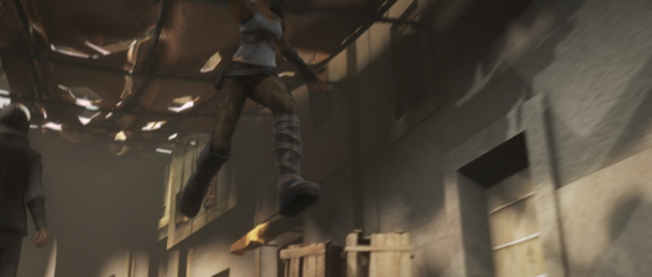

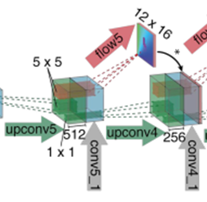


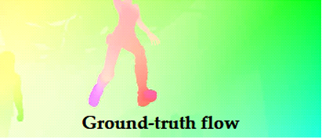

FlowNet
Fine local information procided in lower layer feature
Full-scale
Coarsest level
Full-scale estimate
Estimation at coarsest scale
fine local information
Full-scale estimate

Slide 13
FlowNet
How predict flow in each layer?
Activation function : Rectified Linear Unit
Loss fuction : End point error (EPE)
EPE loss
EPE loss
EPE loss
0.01
0.02
0.08
EPE loss
0.005

Slide 14
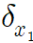
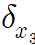
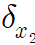
FlowNet
How predict flow in each layer?
Learning predicting flow!

Slide 15
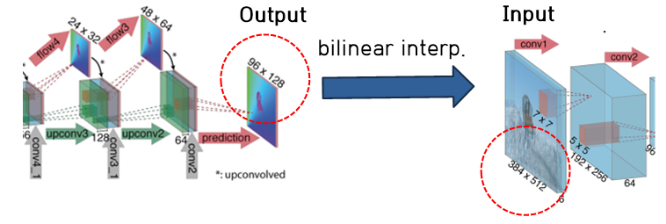
FlowNet
Coarse to fine + variational method

Slide 16
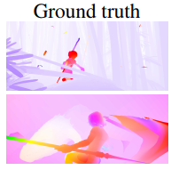
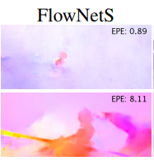
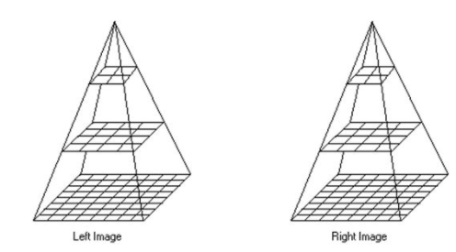
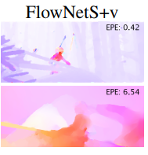
FlowNet
variational method
장점 :smooth하고 subpixel대한 문제를 해결해주어 error가 작아짐
단점 : 1s 정도 걸려서 real time이 힘들다.
coarse to fine + energy minimization

Slide 17
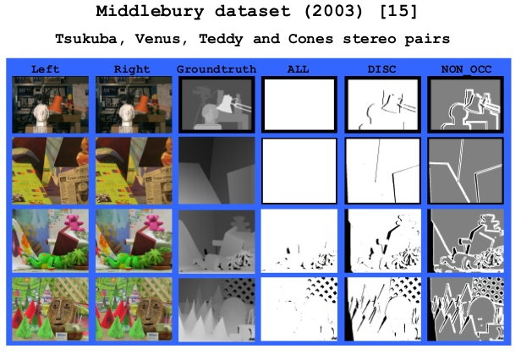
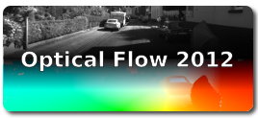
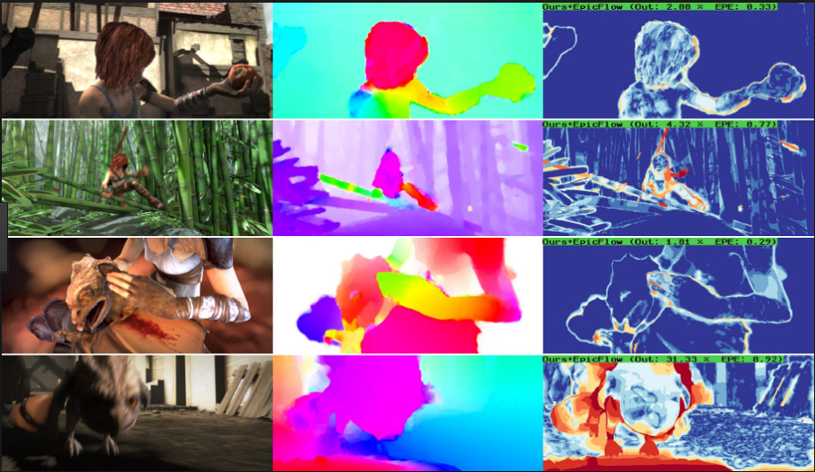
FlowNet
Lack of labeled data
=> Difficult to make ground truth of optical flow
segmentation
object detection
optical flow
making gt by sensor
no sensor!
Middlebury dataset
Kitti dataset
MPI sintel
MPI sintel (2012)
194 grountruth image
large displacement
but, rigid scene by moving observer
1041 grountruth image
8 grountruth image
small and large displacement
but, still small data
Displacements are very small
Lack of data

Slide 18
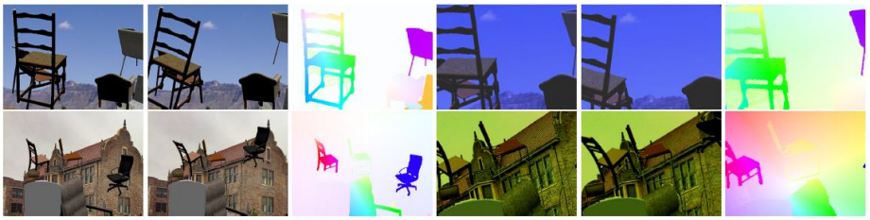
FlowNet
Lack of labeled data
- Flying Chairs dataset
-Flying chair rendered with 3D shapes
-Background: static image with affine transform
-Rendering out flow result

Slide 19
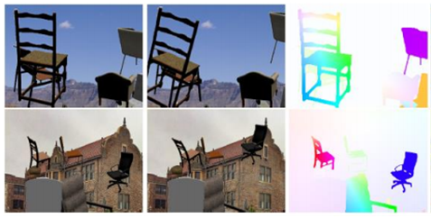
FlowNet
Training
Max iteration : 1200K
training
~300k : 1e-4
300k ~ 1200k : divided by 2 per 100k
with Flying Chairs
training set : 22,232
test set : 640
Fine tunning
1200k ~ : 1e-6 (fixed)
with MPI sintel
training set : 908
test set : 133
MPI sintel (2012)

Slide 20
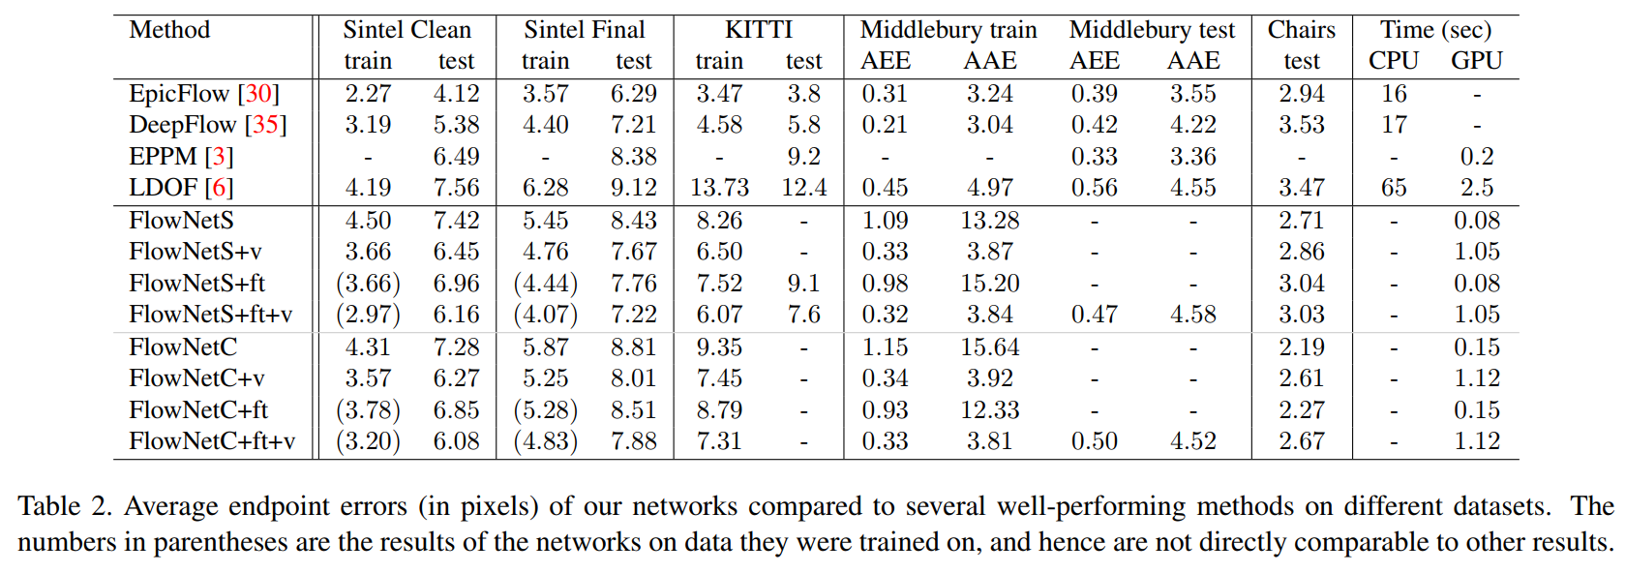
FlowNet
Result
=> FlowNetC outperforms FlowNetS on sintel and Flying chairs
=> In Kitti, FlowNetC have problems with large displacements

Slide 21
FlowNet
Result
=> Even though FlowNet is often better,
but cannot compete with traditional method

Slide 22
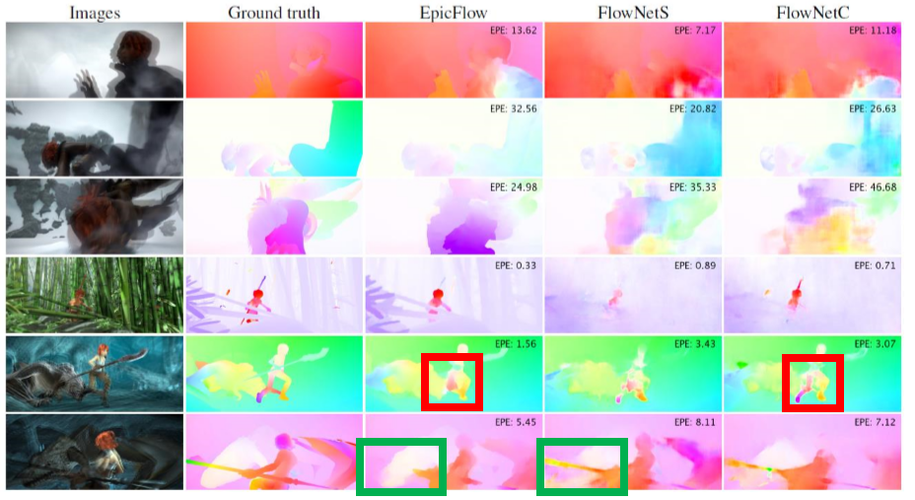
FlowNet
Result
=> 기존 handcraft 알고리즘 보다 정확성이 많이 떨어짐
=> energy minimization 의 알고리즘의 도움이 필요.

Slide 23
FlowNet Review
FlowNetS
FlowNetC

Slide 24
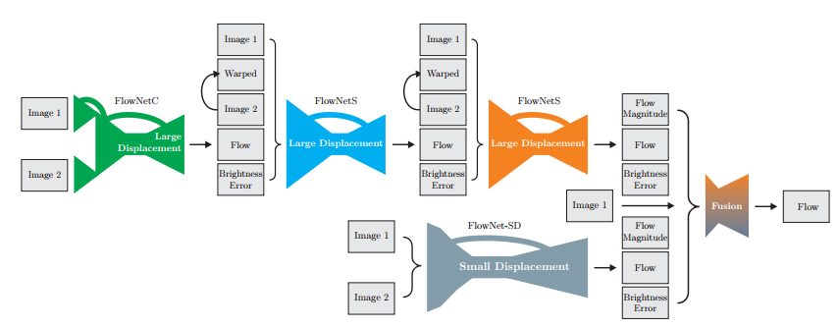
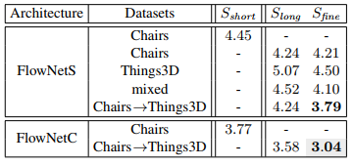
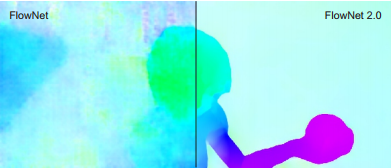
FlowNet 2.0
Flownet 2.0: Evolution of Optical Flow Estimation with Deep Networks

Slide 25
FlowNet 2.0
Improvement of FlowNet 2.0
- Dataset Schedules (데이터 학습 방법 변경)
- Stacking Multiple Diverse networks (Energy 방법 대체)
- Small Displacement Network and Fusion

Slide 26
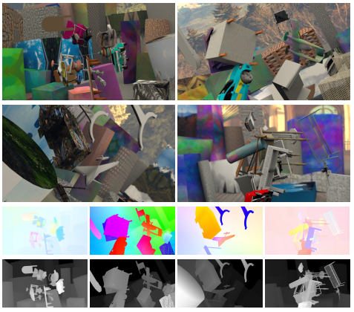
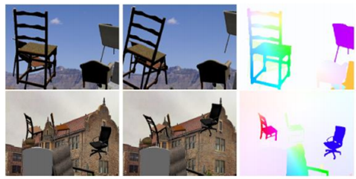
FlowNet 2.0
Data Schedules
FlowNet 2.0
- FlyingThings3D
=> show true 3D motion,
lighting effect and various model
FlowNet
- FlyingChairs
=>contain only planar motions

Slide 27
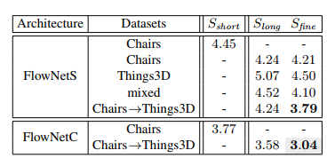
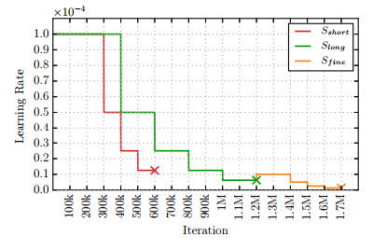
FlowNet 2.0
Data Schedules
FlowNet 2.0
best!!
Flying Chairs
learning general concept of color matching
FlyingThings3D
learning detail 3D motion and lighting effect

Slide 28
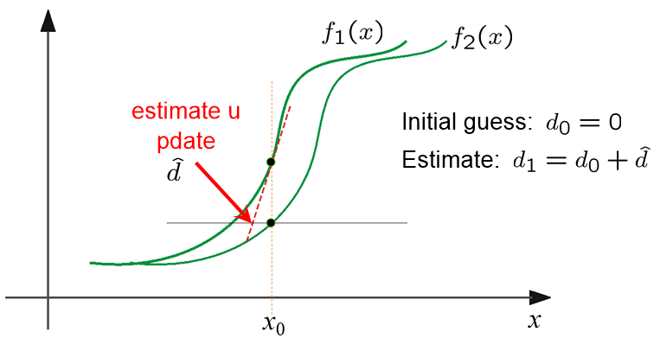
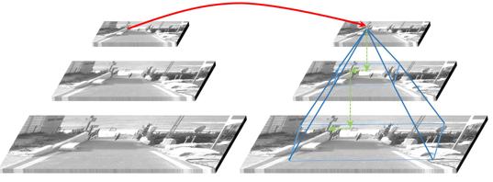
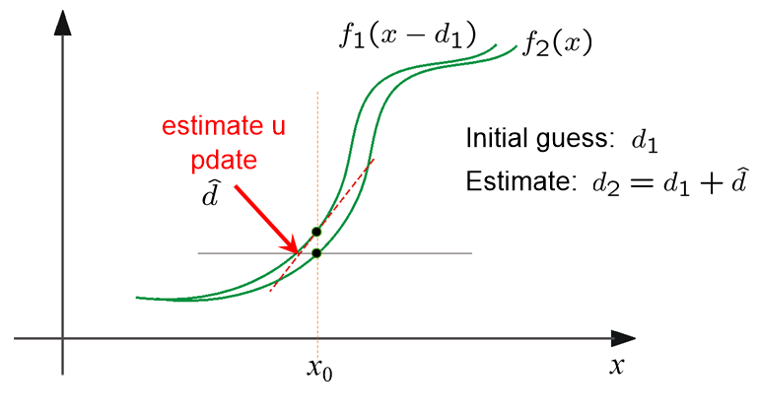
FlowNet 2.0
Stacking Multiple Diverse Networks
=> 많은 optical flow들이 iterative method를 사용
=> 딥에서도?
FlowNet 2.0

Slide 29
FlowNet 2.0
Stacking Multiple Diverse Networks
=> 2번째 네트워크의 input은?
FlowNet 2.0

Slide 30
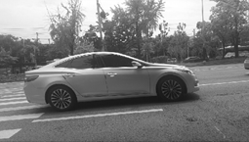
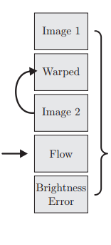
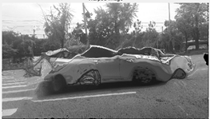
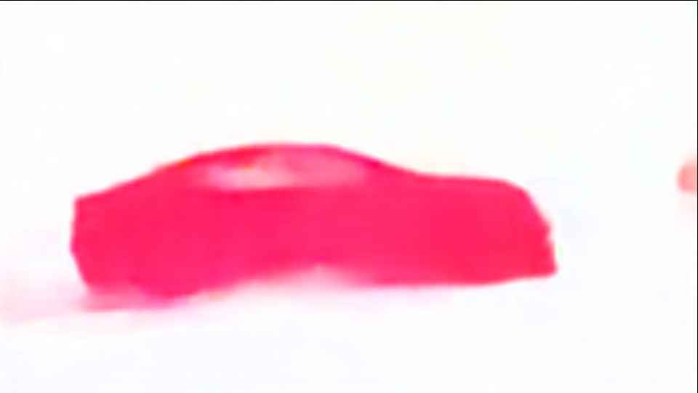
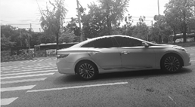
FlowNet 2.0
Stacking Multiple Diverse Networks
FlowNet 2.0의 인풋은?
image1
error
warped image2
image1 - W_image2
Flow
image2

Slide 31
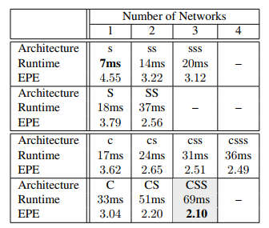
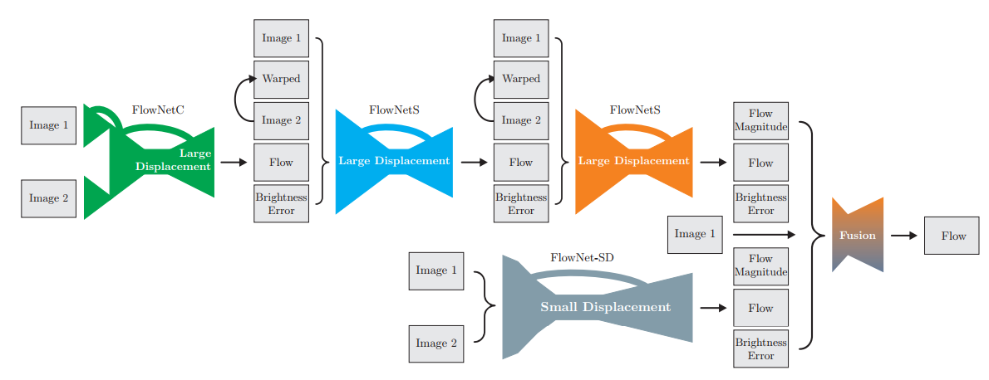
FlowNet 2.0
Stacking Multiple Diverse Networks
FlowNet 2.0

Slide 32
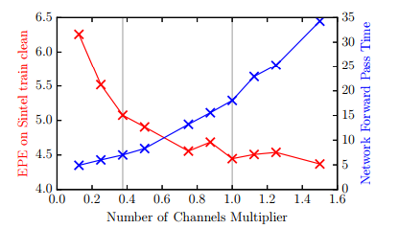
FlowNet 2.0
Stacking Multiple Diverse Network
FlowNet 2.0
- Varying Network Size
=> Factor 3/8 yields a good trade-off between speed and accuracy
a single FlowNetS
performance
version
original
version

Slide 33
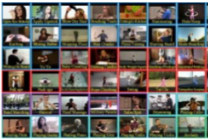
FlowNet 2.0
Small Displacements
- the network cannot relably estimate small motions
Difficulty in optical flow
-large displacement-
?
Because of datasets
Training
Test
Fast Motion dataset
Not working in slow motion !
Flying Chairs
UCF101 dataset
MPI sintel

Slide 34
FlowNet 2.0
Small Displacements
- the network cannot relably estimate small motions
=> making new dataset and more doing fine-tune
FlyingChairsSDHom
fine tune
?
FlowNet2-CSS => FlowNet2-CSS-ft-SD
=> contain small displacement

Slide 35
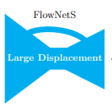
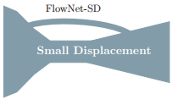
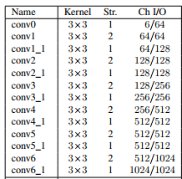
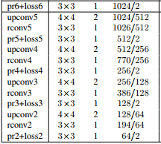
FlowNet 2.0
Small Displacements
- making new dataset and more doing fine-tune
=> In case of subpixel motion, noise still remains
replace all kernel size by 3x3
add conv between upconv

Slide 36
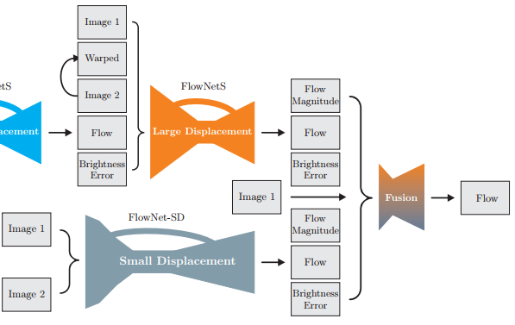
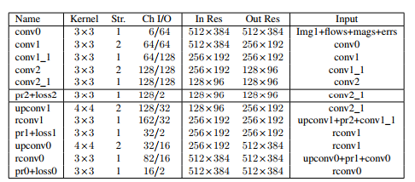
FlowNet 2.0
Small Displacements
- Fusion Layer
Full resolution!

Slide 37

FlowNet 2.0
Result
- 기존 FlowNet의 성능에 있어 큰 향상 (handcraft 알고리즘보다 좋음)
- 속도면에서도 월등

Slide 38

FlowNet 2.0
Result

Slide 39








FlowNet 2.0
Result
Image Overlay
FlowNet 2.0-ss
EpicFlow
coarse to fine Algorithm

Slide 40
Thank you
Q&A

